Slide 1

Bring it to the Altar
A day of prayer and intercession

Slide 2
VISION FOR TODAY
Phillip 4:6 Be careful for nothing; but in every thing by prayer and supplication with thanksgiving let your requests be made known unto God.
Psalms 6:9 The Lord has heard my supplication; the Lord will receive my prayer

Slide 3
A good place to start, is to start right at the beginning …..

Slide 4
Eph 1:3 – 6 Blessed be the God and Father of our Christ, who has blessed us with all spiritual blessings in heavenly places in Christ: According as he has chosen us in him before the foundation of the world, that we should be holy and without blame before him in love:

Slide 5
1Pe 1:19-20 But with the precious blood of Christ, as of a lamb without blemish and without spot: Who verily was foreordained before the foundation of the world but was manifest in these last times for you.
proginōskōto know beforehand, i.e. foresee - foreknow (ordain), know (before).
Rev 13:8 And all that dwell upon the earth shall worship him, whose names are not written in the book of life of the Lamb slain from the foundation of the world.

Slide 6
BEFORE GENESIS 1 (EARTH’S CREATION)
Before the foundation of the world was laid:
- Jesus Christ was foreordained to be made manifest
- Jesus Christ was slain
- God knew us and He chose us in Christ.
- Before Adam and Eve were created out the dust of the earth, God already purposed and predestined your existence

Slide 7
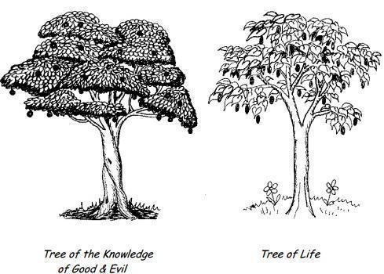
What was the significance of these 2 trees

Slide 8
Gen 1:26 And God said, Let us make man in our image, after our likeness: and let them have dominion [radah …subjucate, reign, rule over] over the fish of the sea, and over the fowl of the air, and over the cattle, and over all the earth, and over every creeping thing that creepeth upon the earth.
Gen_1:28 And God blessed them, and God said unto them, Be fruitful, and multiply, and replenish the earth, and subdue [kabash …to bring under subjection] it: and have dominion rule over over the fish of the sea, and over the fowl of the air, and over every living thing that moveth upon the earth.

Slide 9
All the creatures of the earth were subjected to man and were under the dominion, subjugation, rulership, reign and therefore under the authority of man. Every living creature had to obey man [control and power].
Psa 8:4-9 What is man, that thou art mindful of him? and the son of man, that thou visitest him? For thou hast made him a little lower than the angels, and hast crowned him with glory and honour. Thou madest him to have dominion over the works of thy hands; thou hast put all things under his feet: All sheep and oxen, yea, and the beasts of the field; The fowl of the air, and the fish of the sea, and whatsoever passes through the paths of the seas.

Slide 10
Hierarchy
Man
Living Creatures
QUESTION: If all the earth’s creatures were under man’s feet and subject to man who ruled and reigned over them, then who was man under, who was man subject to and who ruled and reigned over man?
How was man required to demonstrate his subjection and obedience to God?

Slide 11
1Sa 15:22-23 And Samuel said, Hath the LORD as great delight in burnt offerings and sacrifices, as in obeying the voice of the LORD? Behold, to obey is better than sacrifice, and to hearken than the fat of rams. For rebellion is as the sin of witchcraft, and stubbornness is as iniquity and idolatry. Because thou hast rejected the word of the LORD

Slide 12

What happened in the garden
Gen 2:18 And the LORD God said, It is not good that the man should be alone; I will make him an help meet (a counterpart, or mate) for him. And out of the ground the LORD God formed every beast of the field, and every fowl of the air; and brought them unto Adam. He then created the woman who could be his counterpart and mate.
The serpent was a creature of the earth that God had made. Now the serpent was more subtil (cunning, usually in a bad sense , crafty, prudent) than any beast of the field which the LORD God had made. The serpent spoke to Eve and Adam was with her. [Where else in the bible do we see a beast of the field speaking?]
3 parties – 3 curses - Who was cursed?
Serpent - cursed above all cattle and living beast, you will crawl on your belly and eat dust. Question: Is satan a cattle/beast of the field?
satan - He shall bruise your head. Jesus overcame satan. We still face satan as our adversary - Rom 16:20 And the God of peace shall bruise Satan under your feet shortly.
Eve and Adam (man) - thy desire shall be to thy husband, and he shall rule over thee. Cursed is the ground for thy sake; in sorrow shalt thou eat of it all the days of thy life

Slide 13
THE GREATEST LIE
Gen 3:4 And the serpent said unto the woman, You shall surely not die.
The blood of an animal was shed to cover his nakedness and shame (sin)
The blood of an animal became the only sacrifice to cover man’s sin temporarily
Man lost his access to the tree of life and to eternal life on earth
Sin separates us from God and leads to spiritual and physical death

Slide 14
A leopard never changes his spots
satan told Eve -
Did (question)
God (Author)
Really (authenticity)
Say (WORD)
Satan still seeks to cast doubt on the living Word and its Author. If satan can get you to question the Word of God, you automatically reject the Author. John 6:63 It is the Spirit that quickens; the flesh profits nothing: the words that I speak unto you, they are spirit, and they are life
Rev 19:13 And He (Jesus Christ) was clothed with a vesture dipped in blood: and his name is called The Word of God.

Slide 15
Obedience is better than sacrifice …
1Sa 15:22-23 And Samuel said, Hath the LORD as great delight in burnt offerings and sacrifices, as in obeying the voice of the LORD? Behold, to obey is better than sacrifice, and to hearken than the fat of rams. For rebellion is as the sin of witchcraft, and stubbornness is as iniquity and idolatry. Because thou hast rejected the word of the LORD
Heb 10: 8 First he said, “Sacrifices and offerings, burnt offerings and sin offerings you did not desire, nor were you pleased with them which are offered by the law. 9 Then he said, “Here I have come to do your will O God.” He takes away the first that He may establish the second. 10 And by that will, we are sanctified through the offering of the body of Jesus Christ once for all.
Gen 22:17 That in blessing I will bless thee, and in multiplying I will multiply thy seed as the stars of the heaven, and as the sand which is upon the sea shore; and thy seed shall possess the gate of his enemies;
Gen 22:18 And in thy seed shall all the nations of the earth be blessed; because thou hast obeyed my voice.

Slide 16
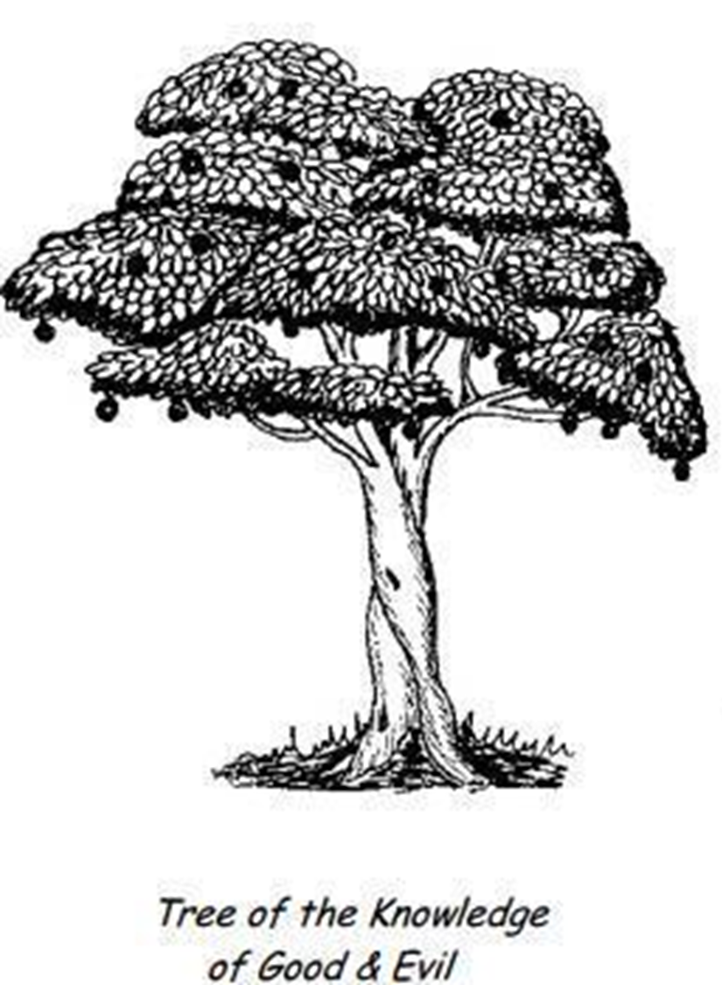
Hierarchy
God
Man
Living Creatures
Gen 4:3 And in process of time it came to pass, that Cain brought of the fruit of the ground an offering unto the LORD.
And Abel, he also brought of the firstlings of his flock and of the fat thereof. And the LORD had respect unto Abel and to his offering:
Romans 12: 1 present your bodies a living sacrifice, holy, acceptable unto God, which is your reasonable service.
Man’s free access to life in abundance as he obeys the Word of his Creator which is his offering and subjection to God, his Creator.
Obedience brings life and blessings
Man’s free-will OFFERING of OBEDIENCE and SUBMISSION to His Creator.
Each time he walked past this tree, his obedience to the Word of his Creator was his offering and submission

Slide 17
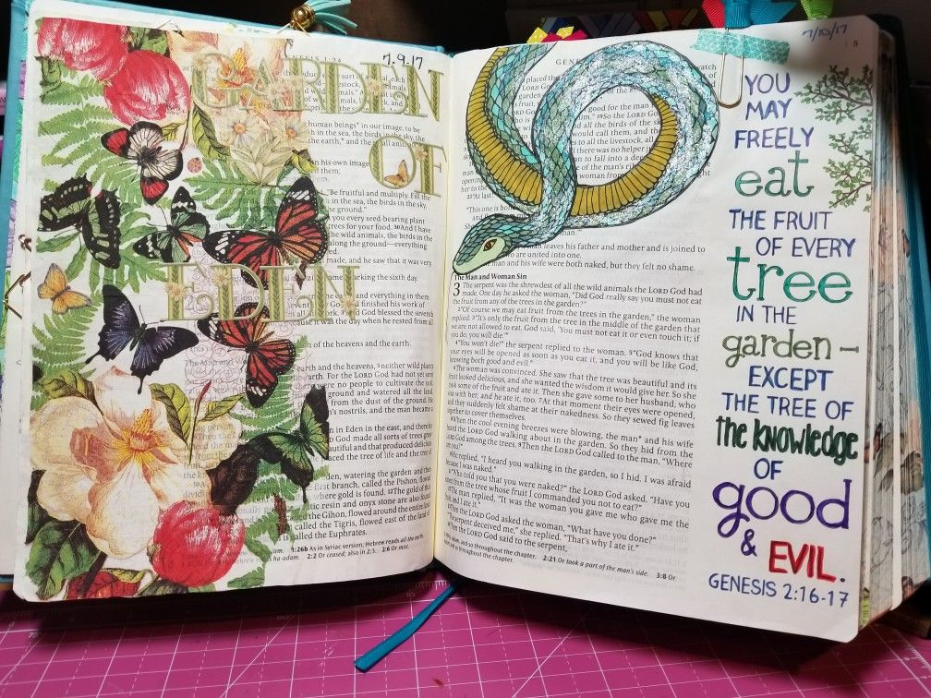
Creation
OFFERING OF SUBMISSION TO HIS CREATOR

Slide 18
A good place to start, is to start right at the beginning …..

Slide 19
THE WORD IS UNDER ATTACK
Gen 1:1 In the beginning God created the heaven and the earth.
John 1:1-3, 14 In the beginning was the Word, and the Word was with God, and the Word was God. The same was in the beginning with God. All things were made by him; and without him was not any thing made that was made… Joh 1:14 And the Word was made flesh, and dwelt among us, (and we beheld his glory, the glory as of the only begotten of the Father,) full of grace and truth.
THE WORD EXISTED BEFORE THE BEGINNING. THE WORD WAS WITH GOD AND ALL THINGS WERE MADE BY THE WORD AND NOTHING WAS MADE WITHOUT THE WORD AND THE WORD BECAME HUMAN AND THE WORD LIVED AMONGST US.
Rev 19:13 AND HE (JESUS CHRIST) WAS CLOTHED WITH A VESTURE DIPPED IN BLOOD: AND HIS NAME IS CALLED THE WORD OF GOD.
The integrity of the bible is under attack, men have devised all manner of arguments to refute the validity and accuracy of the bible.
Did (question) God (Author) Really (authenticity) Say (WORD) – A leopard never ….

Slide 20
THE WORD IS UNDER ATTACK
2 Ti 3:16-17 All scripture is given by inspiration of God, and is profitable for doctrine, for reproof, for correction, for instruction in righteousness: That the man of God may be perfect, thoroughly furnished unto all good works.
Jesus prayed: John 17:17 Sanctify them through thy truth: thy word is truth.
Joh 8:32 And ye shall know the truth, and the truth shall make you free.
2Pe 1:20-21 Knowing this first, that no prophecy of the scripture is of any private interpretation. For the prophecy came not in old time by the will of man: but holy men of God spake as they were moved by the Holy Ghost.
Pro 30:5 Every word of God is pure: he is a shield unto them that put their trust in him
Eph 6:13 Wherefore take unto you the whole armour of God, Eph 6:17 And take the helmet of salvation, and the sword of the Spirit, which is the word of God

Slide 21

Satan knows the Scriptures. Psalm 91:11–12 was quoted by Satan when he tempted Jesus in the desert (Matt. 4:6). Of course, he misapplied it for his own evil purposes. In no way do these verses mean that believers should put themselves in unnecessary danger.

Slide 22
QUOTING SCRIPTURE FOR EVIL GAIN
In Genesis 2-3, Satan knew what God commanded Adam and tempted the first couple by reciting a twisted version of God’s words back in the form of a question. Eve attempted to respond to Satan with what God actually said, but only offered a loose paraphrase, omitting some significant truths.
Again, Satan used God’s Word when he confronted Jesus in the wilderness (Matthew 4:1-11). In the process of trying to tempt Jesus to sin and thereby cause Him to fail as Messiah and Redeemer, Satan quoted Psalm 91:11-12 saying, “If you are the Son of God, jump off! For the Scriptures say, ‘He will order his angels to protect you And they will hold you up with their hands so you won’t even hurt your foot on a stone.’” (Matthew 4:6)
In this passage Satan used Scripture for his own evil purposes. He tried to manipulate Jesus into claiming a promise of God in a way it wasn’t intended. Jesus had just asserted His faith and dependence on the Father by refusing to turn stones to bread. So Satan tried a reverse tactic and in effect said, “OK, so you want to prove you are dependent on the Father? Jump and let Him protect you! God’s Word says you can.”
Satan was using the authority of Scripture to suggest Jesus would be justified in risking His life arbitrarily and then expecting God to protect Him. The Devil’s tactic here was to purposely set one Scripture against another, stressing one passage and disregarding others that should go with it.
“Doesn’t the Bible somewhere say something like…?” This amounts to bits of out-of-context verses paraphrased and strung together like a necklace, supporting presuppositions contradicting what Scripture says in the plainest of language elsewhere.

Slide 23
Keep your friends close and your enemies closer

Slide 24
What does the Bible say about Spiritual Warfare?
2 Corinthians 10:4-5 discusses the warfare of spirit, saying - For the weapons of our warfare are not carnal (flesh), but mighty through God to pulling down strong holds. Casting down imaginations, and every high thing that exalts itself against the knowledge of God, and bringing into captivity every thought to the obedience of Christ.
Isa 54:17 No weapon that is formed against thee shall prosper.
1Tim 1:18 This charge I commit unto thee Timothy, according to the prophecies which went before on thee, that by them you might war a good warfare

Slide 25
Some questions to ask yourself…
Do you know your enemy and his strategies?
How much awareness do you have of spiritual warfare?
What do you understand by spiritual warfare?
Are you engaged in spiritual warfare?
Are you winning or losing?

Slide 26
C.S. Lewis wrote, “There are two equal and opposite errors which our race can fall into regarding evil spirits.
One is to disbelieve their existence.
The other is to believe and feel an unhealthy interest in them.
These devils themselves are equally pleased by both errors....”
To ignore the existence of evil spiritual forces that really exist leaves us vulnerable to attacks that we don’t even recognize as attacks.
The other equal danger is to be so conscious of potentially destructive spiritual activity that we see it in everything even where it neither exists nor operates. To say “the devil made me do it” when we did it ourselves is to avoid personal responsibility and thus fail to learn and grow through our mistakes.

Slide 27
The Truth About Spiritual Warfare?
Everything that occurs in the visible, physical world is directly connected to the wrestling match being waged in the invisible, spiritual world.
The effects of the war going on in the unseen world reveal themselves in our strained and damaged relationships, emotional instability, mental fatigue, physical exhaustion and many other areas of life. Many of us feel pinned down by: anger, unforgiveness, pride, watching others and feeling like you fall short in comparison, insecurity, discord, fear. . . and the list goes on.
Rom 7:23 but I see another law at work in me, waging war against the law of my mind, and making me a prisoner of the law of sin at work within me, 25 Thanks be to God, who delivers me through Jesus Christ our Lord!
Truth: The enemy behind all these manifestations is the Devil himself.“
Truth: Our biggest problems are actually spiritually rooted.
Truth: The enemy attacks us primarily in our thoughts and imagination.

Slide 28
UNDERSTANDING THE DEMONIC STRUCTURES
Eph 6:11-13 Put on the whole armour of God, that ye may be able to stand against the wiles of the devil. For we wrestle not against flesh and blood, but against principalities, against powers, against the rulers of the darkness of this world, against spiritual wickedness in high places. Wherefore take unto you the whole armour of God, that ye may be able to withstand in the evil day, and having done all, to stand.
Our battle is against the organised hierarchy of the kingdom of darkness namely:-
Principalities (archai) satanic princes, set over nations and regions; they control the world for Satan and work through religions, occultism, finances, politics, sex
Powers (exousia) – they carry out or execute the plans of Satan and the Principalities who work directly under Satan
Rulers (komokratoras) both supernatural and natural world governments/ rulers who are under the Power
Spiritual wickedness (Pneumatikos) multitudes of evil spirits that commonly afflict men e.g. Sickness, death, afflictions, bondages, etc.

Slide 29
POWER OVER THE DEMONIC REALM
Col 1:16 For by Him were all things created, that are in heaven, and that are in earth, visible and invisible, whether they be thrones, or dominions, or principalities, or powers: all things were created by Him, and for Him: 17 And He is before all things, and by Him all things consist.
Col 2:15 And having spoiled principalities and powers, he made a shew of them openly, triumphing over them in it.
1Cor 15:57 But thanks be to God, which giveth us the victory through our Lord Jesus Christ.
1John 5:4-5 For whatsoever is born of God overcomes the world: and this is the victory that overcomes the world, even our faith. Who is he that overcomes the world, it is he that believes that Jesus is the Son of God
Rev12:11 And they overcame him by the blood of the Lamb, and by the word of their testimony

Slide 30
KNOW YOUR ENEMY
We have three principal enemies:
(In warfare you need to know your enemies!)
1) the flesh
2) the world
3) the devil
Ephesians 2:1-3 (NIV) As for you, you were dead in your transgressions and sins, in which you used to live when you followed the ways of this world and of the ruler of the kingdom of the air, the spirit who is now at work in those who are disobedient. 3 All of us also lived among them at one time, gratifying the cravings of our flesh and following its desires and thoughts. Like the rest, we were by nature deserving of wrath.

Slide 31
2 Co 10:4 For the weapons of our warfare are not carnal, but mighty through God to the pulling down of strong holds
Mar 3:27 No man can enter into a strong man's house, and spoil his goods, except he will first bind the strong man; and then he will spoil his house.
- Spiritual warfare requires that you study your enemy
- Spiritual warfare requires you to know your enemy’s plan of attack.
- No Soldier engages in warfare without being skilled in the art of war
- No Soldier enters warfare without a plan of counter attack
- No Soldier enters the battle without his armour of protection
- No Soldier engages in battle without his weapons of defense

Slide 32
The apostle Paul here states that we are engaged in a warfare, and that we have weapons with which we must fight. As Paul states in Ephesians 6:12, our fight is not with flesh and blood, with people, but with the host of demons that work to defile, destroy, harass, tempt and enslave mankind.
Part of the good news in Christ is that now, we can resist the devil's influence in our own lives.
God has given us mighty weapons to counter satanic influence and activity. But in order to be effective in our warfare, we must know what these weapons are, and how to use them effectively.

Slide 33
A major part of our challenge is first to know who is talking, we must discern which spirit is motivating us to behave or act in a certain way, and to then respond intelligently in the light of what God reveals in His Word.
We must develop spiritual discernment.
One of satan's major strategies is to keep us from really perceiving with our hearts who God truly is. That is why Paul said our weapons cast down every high thing which exalts itself against the knowledge of God.

Slide 34
WEAPON: PRAISE
PRAISE is a major weapon against Satan.
Satan and demons just HATE hearing people praise God, especially when they do so from a pure heart.
Praise welcomes the presence of God in a way that Satan cannot resist. If we would praise God more, we would have far less interference from demonic powers in our lives.

Slide 35
The strength which God has ordained for us is perfect praise.
Perfect praise SILENCES the enemy. Many of our problems would be solved if we could only get Satan and his demons to be silent.
Evil spirits operate by injecting suggestions into our minds which seem reasonable, but are rooted in unbelief and rebellion towards God.
The suggestions come as if they were our own thoughts, when they are not at all! We lose battles when we believe and trust these demonic suggestions.
These suggestions, thoughts and imaginations work to sow discouragement, confusion, fear, doubt, hurt, rejection, hopelessness and unbelief in our minds. PRAISE - be it spoken or sung to music, however, works to bring in the presence of God wo inhabits our praises, and which SILENCES the enemy.

Slide 36
It is no accident that David, perhaps the mightiest warrior for God in Old Testament times, was a man of praise.
His strength was rooted in the joy he found in God through praising and worshiping God.
How much more in these New Testament times, we, who are commanded to "continually offer up to God the sacrifice of praise, the fruit of lips which confess His Name" (Hebrews 13:15), are called to overcome the devil and his demons, and all their works, using PRAISE as a mighty God ordained weapon for the destruction of their plans and works.

Slide 37
WEAPON - THE WORD OF GOD
When Jesus was tempted in the wilderness by Satan (see Luke 4:1-13),
He overcame the devil using the weapon of THE WORD OF GOD. Rather than arguing directly with Satan's suggestions, as many Christians try to do, Jesus simply quoted the Word of God as it applied to the suggestion.
When Satan tried to suggest a course of action for Jesus to prove his divinity and simultaneously satisfy his hunger, Jesus answered, "It is written, ' Man shall not live by bread alone, but by every word of God.'' (Luke 4:4).

Slide 38
The apostle John wrote, "I have written to you, young men, because you are strong, and the Word of God abides in you, and you have overcome the wicked one." (1 John 2:14).
We see then that we are called to grow up, and the Word of God must abide in us, and "no longer children, tossed about by every wind and wave of doctrine" (Ephesians 4:14).
It is when, through much study and meditation on the Word of God, that word comes to live in us, and consume our thoughts, that we will be strong in the Lord.
Jesus promised that if we abide in Him, and His Word abides in us, we will ask what we desire, and it will be done for us (John 15:7). This will include victory over satan.

Slide 39
WEAPON: THE BLOOD OF JESUS
One of Satan's chief tactics is accusation. He is called "the Accuser of the brethren". When we sin we give Satan opportunity to accuse us, both directly and through others.
The reality is, we have all sinned. When Satan adds his accusations to our sin,, we can become condemned and discouraged if we are ignorant of the power of the blood of Jesus as it may be applied to this issue.

Slide 40
Praise God, the blood of Jesus Christ, God's son, cleanses us from all sin. "If we confess our sins, he is faithful and just to forgive us our sins and to cleanse us from all unrighteousness." (1 John 1:9).
We must believe that no matter what sin we may commit, the blood of Jesus is there to cleanse us.
We can be restored by this blood to a place of acceptance with God and peace with ourselves.
It is because Jesus paid the price for our sins, and took the punishment we deserve, that we can be forgiven and still press on after temporary defeats.

Slide 41
WEAPON - PRAYER
Prayer is not preparation for the battle.
Prayer is the battle. We are commanded to pray without ceasing, so we should at least aim for it.
God has made so many promises regarding prayer and we need to fill our hearts and minds with these promises.
Of course, volumes could be written on prayer and have been in various places. Learn to pray with power.
When we prevail in prayer, Satan is defeated, miracles happen and people turn from the power of Satan to the power of God, their eyes having been opened.
Prayer is quite simply the key to revival. YOU MUST PRAY.
To not pray is to surrender to Satan

Slide 42
WEAPON - THE POWER OF YOUR TESTIMONY
Tell other people what Christ has done for you.
This will promote faith. Tell yourself - you need to encourage yourself in the Lord - "forget not all His benefits".
Tell God - praise and thank Him for it.
Paul used his testimony in confronting King Agrippa and the Roman Governor Festus when called to account for his activities and the reasons for which he was accused by the Jews (see Acts 26 - also Acts 22).
They overcame came him [the devil] ... by the word of their testimony.
Are you ready to overcome...lay these things to heart and become a doer of the Word

Slide 43
BATTLE ARMOUR
The Objective is not only to withstand but to also stand
VICTORIOUS

Slide 44
Belt of Truth:
It refers to the truths of Scripture as opposed to the lies of Satan. Satan is the father of lies (John 8:44). Jesus said, “You shall know the truth, and the truth shall make you free”
The Holy Spirit guides us to all truth.
John 16:13.

Slide 45
Breastplate of righteousness-
The breastplate covers the heart and shields it and the other vital organs. The Bible says, “Keep your heart with all diligence, for out of it spring the issues of life” (Proverbs 4:23). That is what Christ’s righteousness does for you. It protects you against all of Satan’s accusations and charges. This righteousness is not made up of the good deeds you do. The Bible is clear that none of us are righteous in ourselves (Romans 3:10).
The breastplate of righteousness is entirely the righteousness of Jesus which He gives us freely when we accept Him as our Saviour

Slide 46
Feet with the gospel of Peace:
Soldiers marching into battle must have comfortable shoes. As soldiers of Christ, we must put on “gospel shoes” that will allow us to march wherever our Lord leads.
The apostle John says, “He who says he abides in Him [Jesus] ought himself also to walk just as He [Jesus] walked” (1 John 2:6).
Jesus said, “My sheep hear My voice, . . . and they follow Me” (John 10:27).
Satan will try to place obstacles in our path, but in Jesus’ strength we can walk forward, following our Lord, obeying Him, and advancing the gospel.

Slide 47
Shield of faith-
In listing the different pieces of the armor of God, Paul says, “Above all, . . . [take] the shield of faith with which you will be able to quench all the fiery darts of the wicked one” (Ephesians 6:16). When Satan attacks with doubts, the shield of faith turns aside the blow. When temptations come, faith keeps us steadfast in following Jesus. We are able to withstand all the devil’s fiery darts, because we know whom we have believed (2 Timothy 3:12).
This faith is not something that comes from within us. It is God’s gift to us. He gives each of us a measure of faith (Romans 12:3). Then as we walk with Him, that faith grows and develops until it becomes a shield, protecting us and allowing us to live a victorious life in Christ.

Slide 48
Helmet of Salvation:
The helmet protects the head—perhaps the most vital part of the body since it is the seat of thought and the mind. When we have a sure knowledge of our salvation, we will not be moved by Satan’s deceptions. When we are certain that we are in Christ with our sins forgiven, we will have a peace that nothing can disturb.

Slide 49
The Sword of the Spirit-
The sword of the spirit is the only weapon of offense listed in the armor of God. All the other parts are defensive in nature. God’s Word—the Bible—is described as “living and powerful, and sharper than any two-edged sword” (Hebrews 4:12).
Jesus used this weapon when Satan tempted Him in the wilderness. To each of Satan’s efforts to lead Him into sin, Jesus replied, “it is written. . . “ and proceeded to quote Scripture to destroy Satan’s temptations.
God’s Word is truth (John 17:17). That is why it is so powerful. That is why it is so important that we study the Bible and become familiar with its truths and its power.

Slide 50
The name of Jesus when called in any situation changes the Arena of Battle
The Holy Spirit helps us in the place of warfare, in prayers making intercession for us, that’s why we must partner with Him in prayer, so we can war a good warfare Romans 8:26-27.
We fight from the place of Victory. The confidence we have is that the finished work of Jesus Christ on the cross , His death and resurrection has given us the VICTORY

